Slide 1

Project Deck: IEOR 4578: Forecasting: A Real-World Application Prof. Syed Haider Online Retail II Data Project Deliverable 2
by:
Ishita Pundir (ip2441)
Saumya Kothari (sbk2171)
Tushar Bura (tb3077)

Slide 2



Agenda
1. Introduction
- Business Problem Definition - Value Creation
2. Problem Definition & Value Creation
3. Process Flow
4. Timeline
3. Data Augmentation
4. Data Processing
- Preliminary Inspections - Cleaning - Aggregation
5. Target Variables & Predictive Variables
6. Exploratory Data Analysis
7. Pre-Modelling
8. Modelling Methodology
- Train, Validation, Test Split
- Facebook Prophet
- Holt Winters Exponential Smoothing
- ARIMA
- SARIMAX
- Accuracy measures
9. Results & Discussions
- Evaluation of every Model
- Comparison of All models
10. Model Selection
11. Future Scope
12. Team Information

Slide 3




Introduction
This project harnesses machine learning and statistical analysis to forecast revenue trends for an online retail company. Using historical sales data, our goal is to build a precise forecasting model. This model will inform strategic decisions on inventory, marketing, and business strategy.
Dataset Description: The project utilizes the "Online Retail II" dataset, a rich and detailed collection of transactional data from a UK-based non-store online retail platform. This dataset was sourced from the UCI Machine Learning repository and includes transactional records spanning two consecutive years (01/12/2009 to 09/12/2011).

Slide 4

Problem
Value Creation
This project addresses the key business challenge of accurately forecasting sales for seasonal retail items. It involves predicting sales volume, understanding customer behavior, and managing inventory efficiently to balance demand.
Improved Inventory Management: Maintaining optimal stock levels, reducing the costs associated with overstocking, & ensuring that customer demands are met promptly
Objective
Accurately forecasting is crucial for optimizing operations, aligning marketing strategies, and ensuring profitability and customer satisfaction.
Competitive Advantage:
In a highly competitive retail environment, the ability to predict and react to market trends ahead of competitors can be a significant advantage.
From:
To:
Initially we examined the exploratory data analysis (EDA) and preliminary analysis of models. We explored some models such as ARIMA, SARIMAX, and were not able to fully understand the effectiveness of the models.
We have robustly used ARIMA, SARIMAX, Holt-Winters Exponential Smoothing, Facebook Prophet & Random Forest Regressor to forecast the Revenue of the shop by accurately measuring the effectiveness of each model using MAPE and RMSE. This multi-perspective outlook helped increase the predictive power and confidence of the models.
Customer Satisfaction and Loyalty: Ensuring stock is available in time increases customer loyalty and satisfaction with the store and brand image.

Slide 5
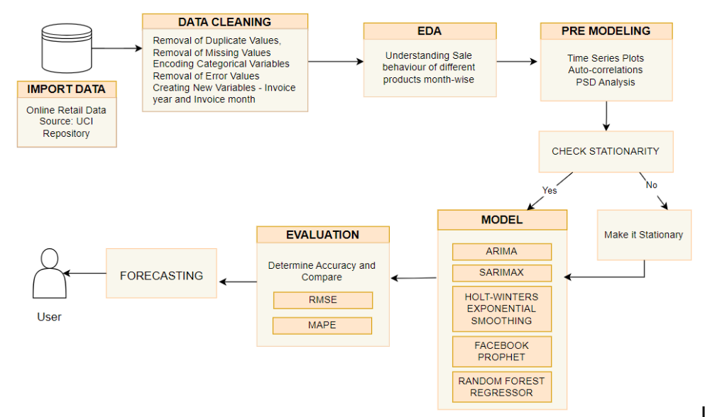
Process Flow

Slide 6
TIMELINE
Data Augmentation
Creating a unified dataframe with all the data of both years 2009-10 & 2010-11
Data Cleaning & Processing
Removing outliers, duplicate entries and removed biases from the data
Exploratory Data Analysis
We display many visualizations from the dataset, using bar graphs, charts and highlighting important statistics.
Used through SARIMAX, ARIMA, Facebook Prophet, Random Forest Regressor and Exponential Smoothing techniques.
Pre-Modelling
Created Power Spectral Density and Autocorrelation graphs
Modelling

Slide 7
Data Augmentation
Data Loading: Utilized Pandas to load two Excel sheets into separate DataFrames. The excel sheets, containing data for the years 2010-2011 and 2009-2010 respectively, were read into these DataFrames.
Data Concatenation: Concatenation was performed along the rows, merging data from 2010-2011 and 2009-2010 seamlessly.
Data Integrity: The unified DataFrame encompassed the complete transaction history for the specified period. Merging ensured data consistency and continuity, laying the foundation for accurate time-series analysis.

Slide 8
Data Processing & Cleaning
Preliminary Inspections: We first observe summary statistics of the dataset. We examine uniqueness and null values. After this, we include data entries limited to the period between December 1st, 2009, and December 9th, 2011, as advised by the author of the dataset. We computed the column 'Revenue' as a product between 'Quantity' and 'Price' columns, serving as a key metric for the analysis.
Cleaning: In the data cleaning phase, efforts were made to enhance the quality of the dataset. Duplicate entries were eliminated to avoid redundancy, while missing values were addressed to prevent biases. Additionally, any erroneous entries or inconsistencies were corrected to maintain the accuracy and reliability of the data. These steps played a pivotal role in preparing a robust dataset for subsequent analysis and interpretation.
Aggregation: Aggregation entails creating 'InvoiceYear' and 'InvoiceMonth' columns from 'InvoiceDate' using pandas' dt accessor. This step facilitates sales data aggregation at monthly or yearly levels, crucial for aligning with typical forecasting models. By breaking down data into smaller time intervals, businesses gain insights into seasonal patterns, trends, aiding in accurate forecasting and strategic decision-making.

Slide 9
Target Variables & Predictive Variables
TARGET VARIABLES:
‘Revenue’
Predictive VARIABLES:
‘invoicedate’
The target variable, also known as the dependent variable, is the primary metric that a predictive model aims to forecast or predict. The target variable, 'Revenue', was calculated by multiplying the 'Quantity' of items sold by their 'Unit Price'. This computation yields the total sales value for each transaction within the dataset.
Predictive variables, also known as independent variables or features, are the inputs used by the model to make predictions about the target variable. These variables are presumed to influence or have a relationship with the target variable, and they are used to train the model on how changes in these variables are associated with changes in the target variable.

Slide 10
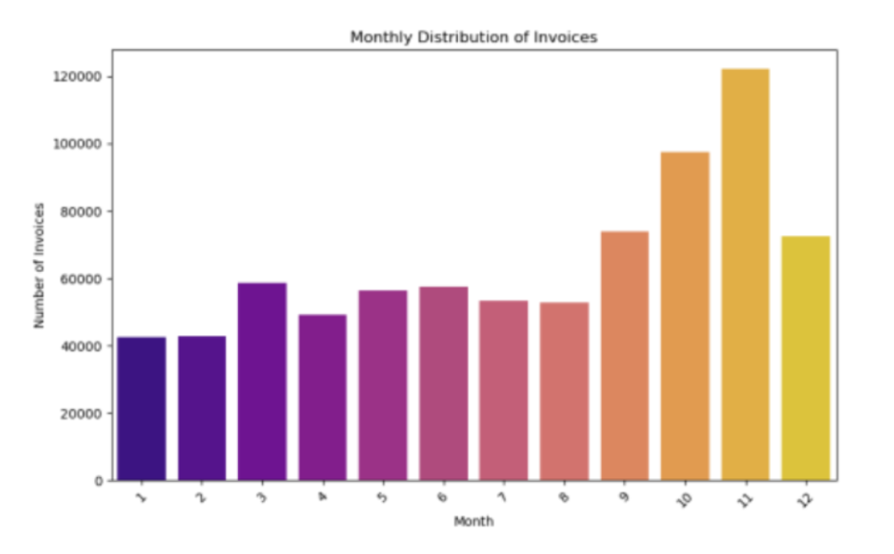
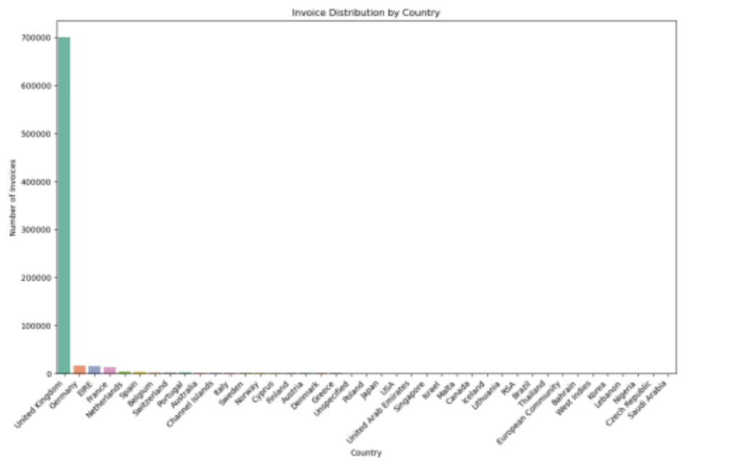
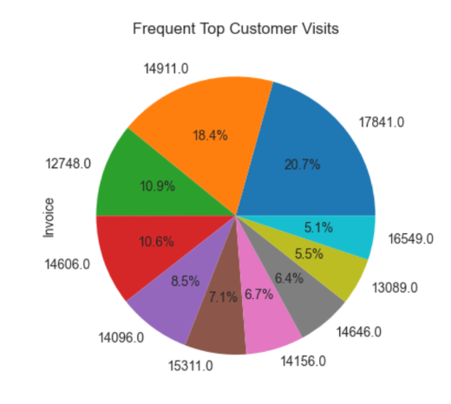
Exploratory Data Analysis
"Monthly Invoice Distribution": seasonal trend with invoice volume peaking towards year-end, possibly due to holiday shopping, or end-of-year sales
“Invoices issued for different countries”: It is immediately apparent that the majority of invoices are attributed to the United Kingdom
“Top customers of a company”: The customer corresponding to the largest segment, with 20.7%, has the highest frequency of visits or transactions.

Slide 11
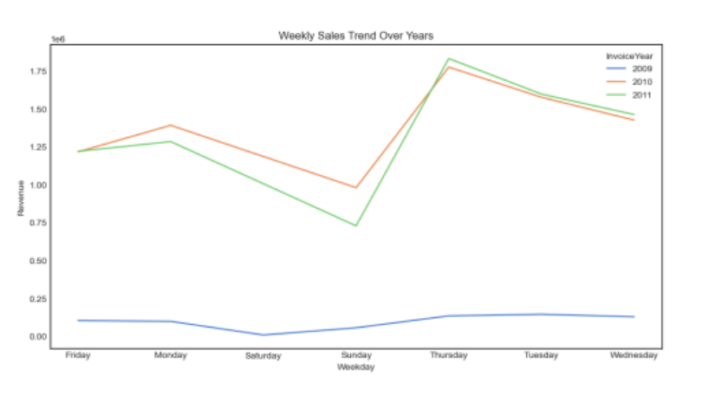
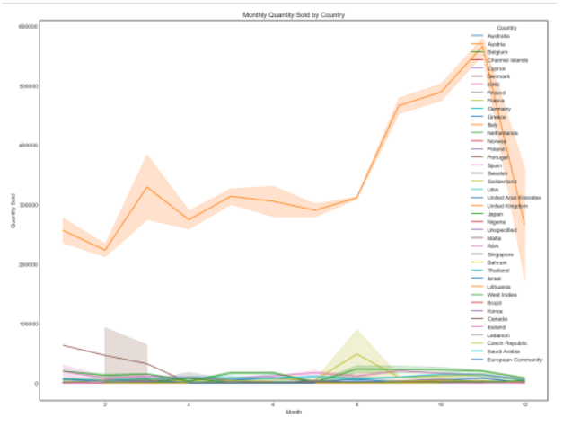
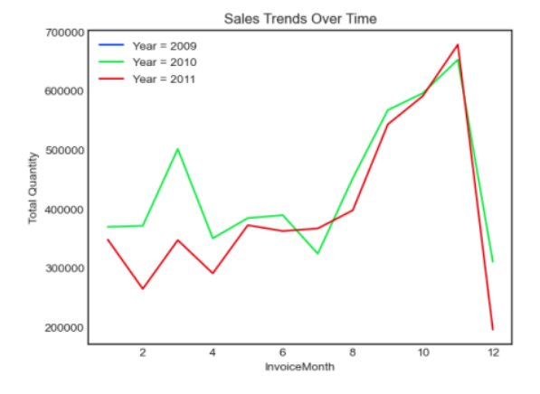
Exploratory Data Analysis
“Weekly Sales Trend”: Midweek Peak: There's a prominent peak in sales revenue on Thursdays for all three years, suggesting that this day might have special significance such as weekly promotions.
“Monthly Quarterly Sales by Country”: The country represented by the top line (UK) has a sales volume that vastly exceeds the others.
“Sales Trend over Time”: There is a visible growth in the total quantity sold from 2009 to 2011, with each subsequent year starting at a higher point than the last.

Slide 12
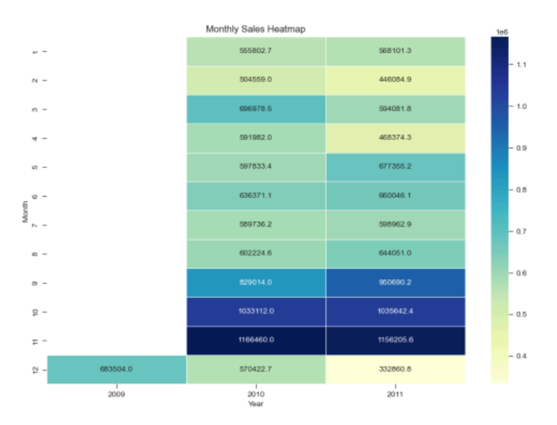
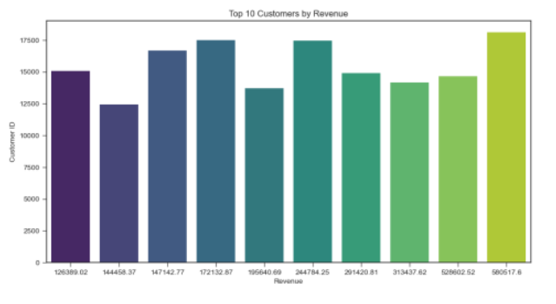
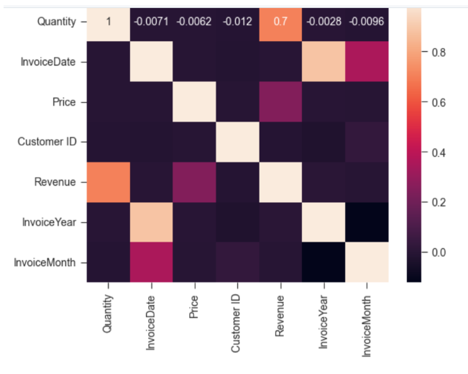
Exploratory Data Analysis
“Monthly Sales Heatmap”: Sales increase towards the end of each year, which is particularly pronounced in 2010 and 2011, likely due to the holiday season.
“Top 10 customers by Revenue”: Identifying these top customers is critical for the company to maintain strong relationships, tailor services, and possibly create loyalty programs to retain these high-value clients.
”Correlation Heatmap”: The image is a correlation matrix heatmap that visualizes the relationship between different variables in a dataset.

Slide 13
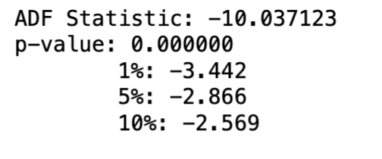
Pre-Modelling
Stationarity Assumption: Stationarity in data refers to constant statistical properties typically including the mean, variance, and autocorrelation structure.
We have used the Augmented Dickey Fuller Test, to check stationarity and made our model stationary.
We can see that the p-value of the stationary dataset is less than 0.05, and hence, we can go ahead with the analysis and modeling.

Slide 14
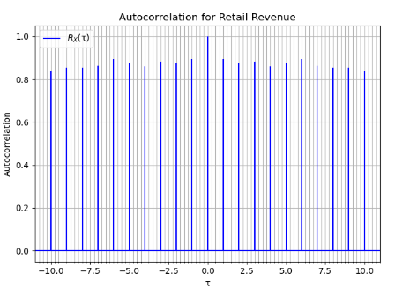
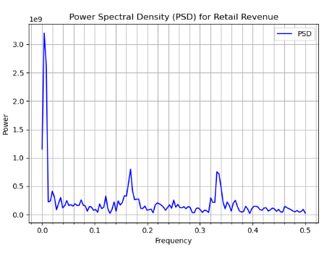
Autocorrection & PSD
Autocorrelation analysis was conducted to identify any correlation between the revenue values at different lags. The plot shows the autocorrelation values for different lag intervals. Additionally, the Power Spectral Density (PSD) analysis provides insights into the frequency components present in the data.
The Autocorrelation graph shows a cyclical pattern in retail revenue, suggesting a seasonal component. The Power Spectral Density (PSD) graph indicates a dominant frequency, which corresponds to the length of this seasonal cycle. These insights can inform your sales forecasting model.

Slide 15
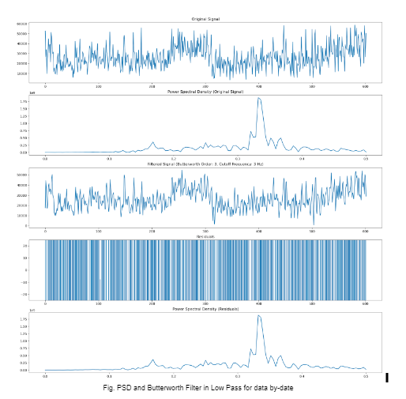
Power Spectral Density (PSD) & Butterworth Filter in Low Pass
The “Original Signal” graph shows a noisy waveform. After applying a filter, as shown in the “Filtered Signal” graph, the noise is significantly reduced. The “Power Spectral Density” graphs before and after filtering show a clear peak, indicating a dominant frequency component in the signal.

Slide 16
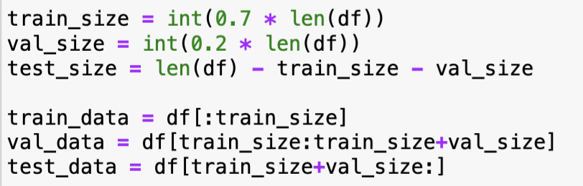
Modelling Methodology
Train, Validation, Test Split: The ratio of split is as follows:
70%: Training Data
20%: Validation Data
10%: Test Data
We have divided the test data into 4 equal parts.
The training set serves as the foundation for training the model, where it learns from the data's patterns and relationships.
Following training, the validation set is employed to fine-tune model parameters and gauge performance, ensuring optimal performance on new data.
Lastly, the test set provides an unbiased evaluation of the model's performance on previously unseen data, confirming its generalization capabilities.
This division enables rigorous assessment and refinement of machine learning models, bolstering their reliability and effectiveness in real-world applications.

Slide 17
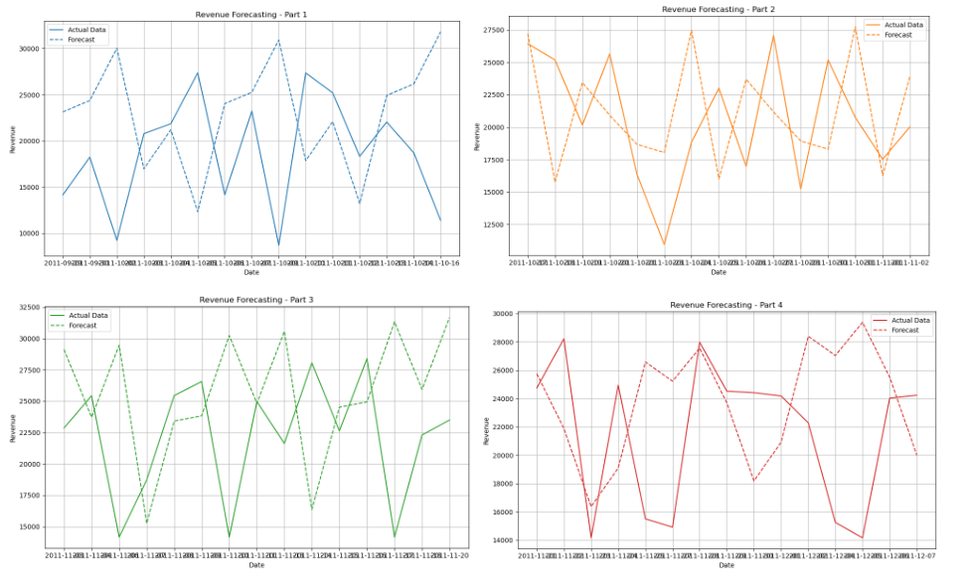
Holt-Winters Exponential Smoothing
Utilized Holt-Winters Exponential Smoothing for retail sales forecasting.
MAPE ranged from 25.38% to 49.15%, indicating varied forecast accuracy.
RMSE ranged from 5818.15 to 11530.80, reflecting forecast discrepancies.
Challenges in capturing seasonality and trends observed.
Further parameter exploration may enhance forecast accuracy.

Slide 18
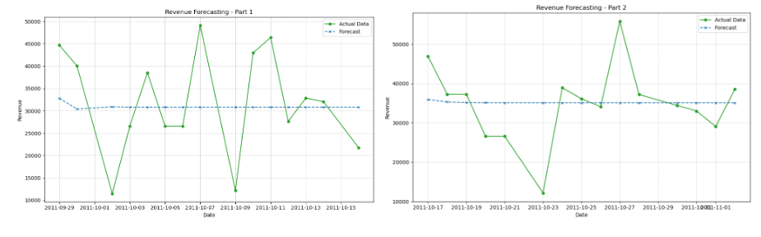
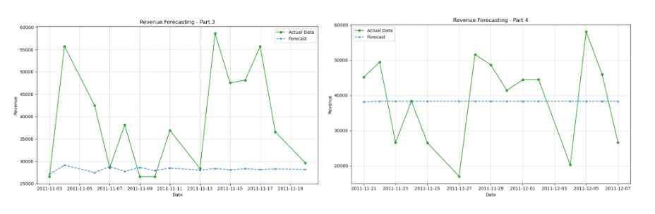
ARIMA
Utilized ARIMA model for retail sales forecasting.
MAPE ranged from 0.24% to 0.40%, indicating high forecast accuracy.
Visual inspection showed closely aligned forecasted values with actual sales trends.
Strong performance demonstrated in accurately forecasting retail sales data.
Slight variations in MAPE across different test data parts suggest areas for further exploration and optimization.

Slide 19
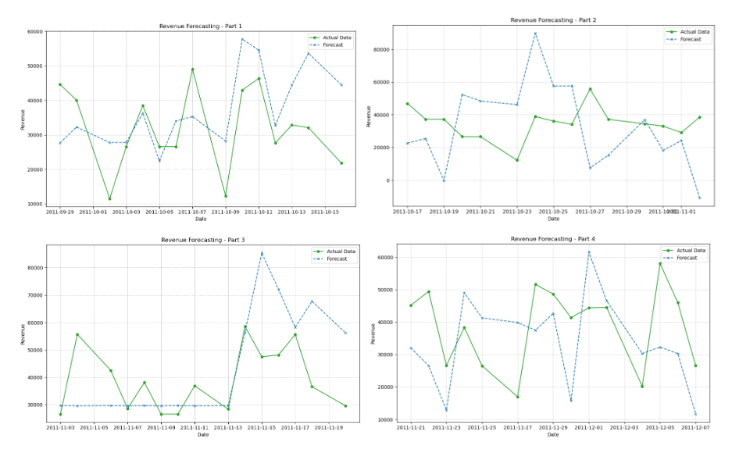
SARIMAX
Employed SARIMAX model for retail sales forecasting, accommodating seasonality.
MAPE ranged from 0.32% to 0.83%, indicating moderate forecast accuracy.
Higher MAPE values compared to ARIMA suggest challenges in capturing seasonality or exogenous factors.
Visual inspection showed varying degrees of accuracy between forecasts and actuals.
Despite challenges, SARIMAX offers a valuable framework for incorporating seasonality and external variables, providing insights into retail sales dynamics.

Slide 20
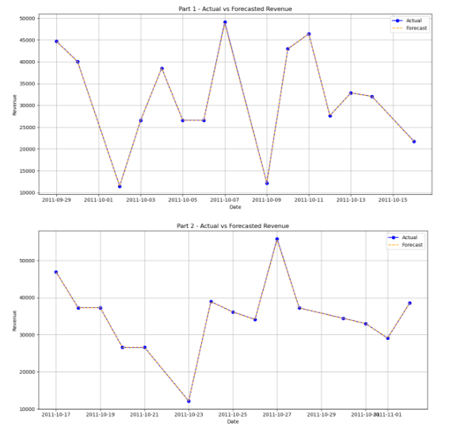
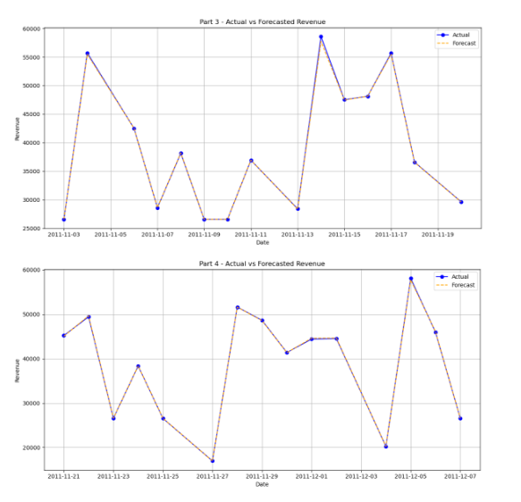
Random Forest Regressor
Achieved low MAPE (0.08% to 0.55%) indicating high accuracy in predicting revenue trends.
Varied RMSE (40.74 to 864.68) highlights forecast accuracy discrepancies.
Overall promising performance with low MAPE values, reflecting accurate forecasts.
Higher RMSE values in some parts suggest areas for further investigation and refinement.

Slide 21
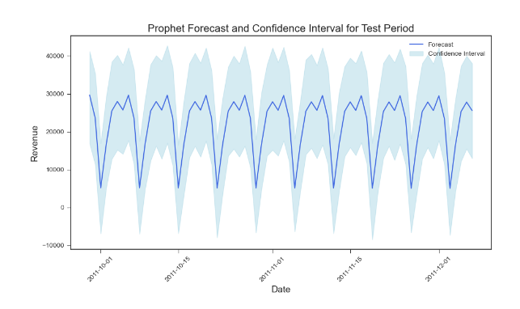
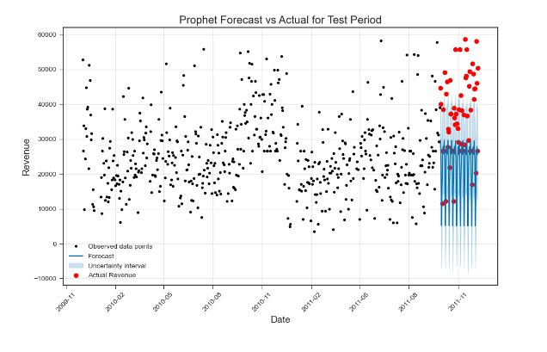
Facebook Prophet
Employed Facebook Prophet for time series forecasting, leveraging automated handling of seasonality and trends.
Achieved consistently low MAPE values (0.39% to 0.43%) across test data parts.
Visual examination confirmed close alignment between forecasts and actuals.
Demonstrated strong performance, providing reliable insights for decision-making.
Automatic features contributed to accurate forecasts, enhancing model effectiveness.

Slide 22
Accuracy Measures
We have assessed the model performance by two commonly used measures:
Root Mean Squared Error (RMSE) is the standard deviation of the prediction errors, and it is scale-dependent.
Mean Absolute Percentage Error (MAPE) is obtained as the mean absolute percentage error function for the prediction and the eventual outcomes.
Preference of MAPE: As MAPE is a relative measure, it allows for the comparison of forecasts across different scales or units of measurement. MAPE expresses errors as a percentage, making it easier for business stakeholders to understand the magnitude of forecasting errors relative to actual values.

Slide 23
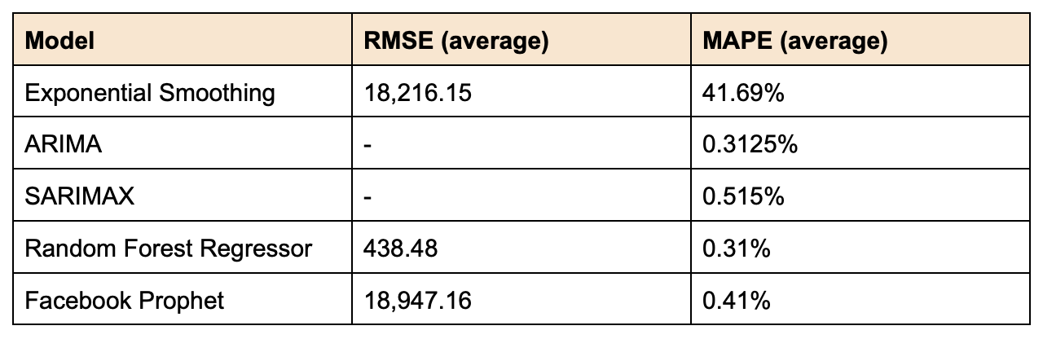
Comparative Analysis of Forecasting Models: MAPE and RMSE Metrics
Based on the provided MAPE results and the features of all the models, Facebook Prophet emerges as the preferred choice over Random Forest Regressor and others.
Reasoning:
Facebook Prophet offers automated handling of seasonality, holidays, and trend changes, reducing the need for manual feature engineering and parameter tuning.
Facebook Prophet provides interpretable forecasts and easily interpretable trend and seasonality components, allowing stakeholders to understand the underlying patterns driving the forecasts.

Slide 24
Future Scope
Granular Forecasting:
Product-Category Level Predictions: Delve into specific categories to uncover nuanced trends, facilitating strategies for inventory optimization and targeted marketing.
Regional Sales Trends: Analyze regional variations in sales patterns to identify underperforming segments and untapped regions for localized business strategies.
Data Enrichment and Model Retraining:
Incorporating Additional Data Sources: Integrate external data sources like economic indicators and social media sentiment to enhance predictive accuracy.
Continuous Learning: Implement ongoing model retraining with new sales data to ensure adaptability to evolving market trends.
Advanced Modeling Techniques:
Deep Learning Models: Utilize Recurrent Neural Networks (RNN) and Long Short-Term Memory (LSTM) networks to model complex relationships in time-series data.
Hybrid and Ensemble Models: Combine traditional statistical methods with advanced machine learning techniques to enhance forecast accuracy.

Slide 25



TEAM
Ishita Pundir
Saum Kothari
Tushar Bura
ip2441
sbk2171
tb3077

